Slide 1
Agile Techniques: Extreme Programming
Dr Steffen Zschaler
Notes:
<CTRL-SHIFT-HOME><CTRL-SHIFT-2>
Welcome.
In this video, we start our exploration of agile techniques by looking at extreme programming – or XP for short.

Slide 2
Extreme programming (XP)
A very influential agile method
Developed in the late 1990s
Introduced a range of agile development techniques
Takes an ‘extreme’ approach to iterative development:
New versions may be built several times per day
Increments delivered to customers every 2 weeks
All tests must be run for every build
Build is only accepted if tests run successfully
Notes:
Extreme programming was developed by Kent Beck in the late 1990s and introduced a range of agile development techniques.
XP is very extreme on the process side: essentially, the focus is on very tight and speedy iterations, with new versions being built potentially many times a day and increments being delivered to customers approximately once every two weeks.
Compare that to the six months to a year a typical plan-based project would take to delivery…
XP’s strength, however, isn’t so much the process – which can easily become a bit “wild west” – but the techniques and tools it introduces.
In particular, XP is focused strongly on building and using a strong, automated test suite and only allows a build to be accepted and an increment to be delivered once all tests pass.
The diagram at the bottom shows the key loop of XP: A “user story” (requirement) is selected to be worked on and broking into detailed tasks, which are then used to plan the next release. The individual tasks are then addressed in a tightly integrated iterative process, the software is released to customers, and their feedback is evaluated to inform the next user story to be worked on.

Slide 3
Extreme Programming (XP) Principles and Practices
Principle or practice | Description
Incremental planning | User stories and story cards for requirements Prioritisation for planning per release cycle Stories broken into development tasks by developers
Small releases | Minimum viable product (MVP): develop minimal useful set of functionality delivering business value first Frequent, incremental releases add further functionality
Simple design | Just enough design
Test-first development | Write tests before implementing solution Automate test execution using unit-test frameworks
Refactoring | Continuously refactor code to keep it simple and maintainable
Pair programming | Developers work in pairs; four eyes see more than two, learn and communicate
Collective ownership | Everyone can make changes everywhere Everyone is responsible for the quality of the whole code base
Continuous integration | Regular releases, possibly more than once a day Supported by powerful tooling for integrating and running tests
Sustainable pace | Overtime is not considered acceptable
On-site customer | Full-time end-user representative on the team
Notes:
Here are some of the key principles and practices of XP. These directly relate to the key ideas in agile development and underpin them with specific practices.
Incremental planning means that there is no point where we plan for the complete development of a software system. Instead, we collect requirements initially as user stories and only prioritise, refine and plan for those requirements that we are tackling for the current release. User stories are broken into individual development tasks by developers as they start working on a given user story.
XP favours small, incremental releases. This requires initially building a so-called minimum viable product (MVP) which contains just enough functionality to provide some initial business value. On top of this MVP, we then develop frequent, incremental releases that add further functionality bit by bit.
Simple design means not designing for every eventuality, but to focus the design on the problem at hand and to keep it as simple as possible.
Test-first development means to build tests before writing code and to automate the execution of tests.
Refactoring is a key technique for continuously improving the code base and ensuring it remains flexible to allow future change.
Pair programming advocates more than one developer collaborating on one piece of code
Collective ownership enables all members of the team to make changes anywhere in the code – an essential pre-requisite for a quality culture.
Continuous integration is another important aspect where tooling helps deliver better software: by integrating and releasing frequently, possibly more than once a day, and safe-guarded by automated test systems, we can ensure consistent progress and functional software
Sustainable pace: this is a key, if perhaps somewhat surprising, aspect of XP: in many plan-driven processes, deadlines create a sort of cliff edge leading developers to cram work and be “heroes”, working late into the night. This is not sustainable both in terms of developer mental health and code quality.
XP was one of the first development approaches to emphasise the need for customers to be on site

Slide 4
Influential XP practices
XP focus is mainly technical
Not easy to integrate with organizational management practices
Consequently, only some of the practices are being used, but the surrounding method has been refined
Practices that survive:
Minimum viable product and incremental releases
User stories for specification
Refactoring
Test-driven development
Pair programming
Notes:
XP is mainly focused on techniques and technologies. As such, it can be difficult to integrate smoothly into an organisations management practices. As a result, while many of the individual practices continue to be used, the overall method has been refined and adjusted over time.
In this video, we will look at some of the key practices that have survived in more detail.
We will start with a look at <ANIMATE> MVPs and incremental releases.

Slide 5
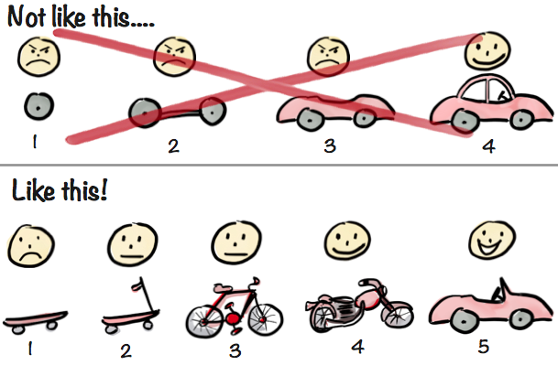
Minimum Viable Product
Henrik Kniberg
Notes:
So what is an MVP and how do we build incremental releases on top of it?
I have always found this metaphor (shown here in a graphic by Henrik Kniberg) helpful in thinking about MVPs. Like any metaphor, it isn’t perfect and, arguably, misses a number of things that are important about MVPs. However, it captures the key idea very well:
The top half of the picture shows one way in which we could approach incremental development for a car (our stand-in for the software system we’re trying to develop). We could start by building one component of the car, say a wheel and then, incrementally, add more components until, eventually, we have built and delivered the complete car.
The problem with this approach is that it delays the delivery of value: It’s really only at Step 4 that we have produced something that can actually be useful to our customers.
In contrast, the bottom approach is closer to how we would use an MVP and incremental development to deliver value throughout the development process. We would start by building a very simple product (say, a skateboard) that, nonetheless already provides some very initial value to our customers – they can get from A to B, but it requires a good deal of effort and there are lots of journeys that cannot really be made yet at all. Safety and speed are also not ideal yet. So, our customers aren’t totally happy yet, but there is a basic platform that demonstrates the overall value proposition and delivers some initial value.
Most importantly, this platform can be incrementally extended as we can see in Step 2 where we have added a new “steering” feature that makes the product much safer and potentially allows more journeys to be undertaken.
We continue adding features in this way – occasionally having to make more fundamental changes to the overall architecture – until we reach the final product. Crucially, at every step along this journey, we have delivered something of increased value to our customer.

Slide 6
Influential XP practices
XP focus is mainly technical
Not easy to integrate with organizational management practices
Consequently, only some of the practices are being used, but the surrounding method has been refined
Practices that survive:
Minimum viable product and incremental releases
User stories for specification
Refactoring
Test-driven development
Pair programming
Notes:
Let’s next look at the use of user stories.

Slide 7
User stories for requirements
Customer / user is part of XP team
Responsible for making decisions on requirements
User requirements expressed as user stories
Simple description of requirement, written by customer/stakeholder
“A reminder to have a conversation with your customer”
“As a <role>, I want <something> so that <benefit>.”^{(Mike Cohn)}
Written on cards
Team break stories into implementation tasks with cost estimates (e.g., S, M, L)
E.g., on back of story card, as separate cards, as post-it notes stuck to the card, …
Customer, together with team, chooses stories for inclusion in the next release
Based on priorities and cost estimates
Notes:
As we have said, in XP, the user is part of the development team and is responsible for making decisions on requirements.
But how are requirements expressed?
<ANIMATE>
In XP, we use user stories, and these are still often used in present-day agile software development.
A user story is a requirement written by a user or stakeholder.
It is typically very broad and more a “reminder to have a conversation” than a detailed worked out requirement.
We will only spend the time to work out all the details when we have decided to actually work on the user story and build an implementation.
A common format for a user story is “As a <role>, I want <something> so that <benefit>.” For example, “As a student, I want to enrol in modules at university, so that I can learn something and increase my career opportunities.”
This structure is important as it ties together information about the stakeholder, the actual requirement and the rationale for the requirement – the benefit or value that it offers to the stakeholder.
User stories are a lot like use cases in that regard, except that they do not yet contain the detailed interaction scenarios.
<ANIMATE>
XP introduced the idea of writing user stories onto filing cards, which has a lot of interesting implications and is something that is still done today.
<ANIMATE>
User stories are a great way for driving team planning. Customers and teams can jointly prioritise user stories and the team then breaks user stories chosen for a particular release into actual tasks to be completed to implement the user story. Tasks can be associated with cost estimates (very rough, for example using T-shirt sizes as a first approximation), which helps with release planning.

Slide 8
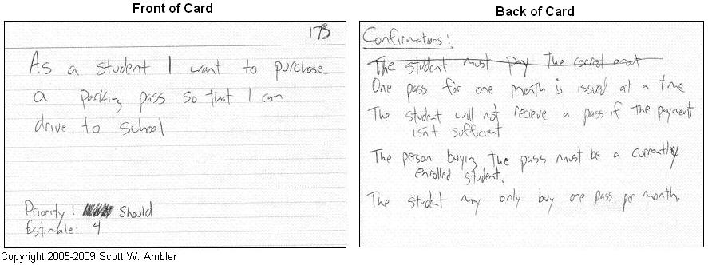
User stories for requirements
Notes:
Here is an example of a user story filing card.
The front of the card shows the user story. “As a student I want to purchase a parking pass so that I can drive to school.” There is also an ID number in the top-right corner to simplify tracking of user stories and some information about cost estimates and prioritisation.
As developers have a conversation with the user about a given card, they will collect more information about the user story. These can be captured on the back of the card.
Using filing cards has one important advantage: there is limited space, forcing conciseness and focus. If the information about a user story or task doesn’t fit on a single card, that’s often an indication that it needs to be broken up into smaller steps.

Slide 9
Influential XP practices
XP focus is mainly technical
Not easy to integrate with organizational management practices
Consequently, only some of the practices are being used, but the surrounding method has been refined
Practices that survive:
Minimum viable product and incremental releases
User stories for specification
Refactoring
Test-driven development
Pair programming
Notes:
Let’s next look at refactoring.

Slide 10
Refactoring
How do we prepare for change?
Conventional wisdom: design for change
Effort will be recouped by later cost savings
XP: not worthwhile, as change cannot be reliably anticipated
YAGNI: You ain’t gonna need it
Instead: constantly improve code base to maintain flexibility
Refactoring: Programming team look for possible software improvements and make them even where there is no immediate need
Guarded by strong regression test suite
Improves understandability and reduces need for documentation
Changes are easier to make because code is well-structured and clear
However, some changes require architecture refactoring
This is much more expensive!!
Upfront design may be more efficient in these cases
Notes:
Agile is all about embracing change, but how do we actually do this?
<ANIMATE>
Conventional wisdom suggests that we need to design for change. We should predict likely change and create an architecture and design that will make it easy to accommodate this change.
XP suggests that this isn’t worthwhile: predicting the specific need for change cannot be done reliably.
The YAGNI principle captures this well: if you are tempted to implement a design for a particular flexibility, remind yourself that You Ain’t Gonna Need It.
<ANIMATE>
Instead, XP suggests that we should aim to maintain a clean codebase and constantly improve it for clarity and maintainability.
This is called refactoring: making a change to the code that improves its structure but maintains its behaviour.
Having a strong, automated regression test suite helps with refactoring as it helps us spot when a change affects the system’s behaviour.
Refactoring done in this way improves understandability of the code and makes it easier to change and extend.
<ANIMATE>
However, there are no silver bullets and some changes will require extensive architecture refactoring (like going from a bicycle to a motorbike).
This will be much more expensive and, at times, upfront design would help us avoid such cost.

Slide 11
Refactoring
Change the implementation without changing the behaviour
Examples:
Re-organization of a class hierarchy to remove duplicate code
Pull up attribute / method
Introduce super class
Tidying up and renaming attributes and methods to make them easier to understand
Align to coding / naming standards
Replacing inline code with calls to methods that have been included in a program library
DRY – don’t repeat yourself
Notes:
So, refactoring is about changing the implementation without changing the behaviour.
Over time, we have developed a large catalogue of general refactoring operations that have proven themselves useful in different contexts.
<ANIMATE>
Here are some examples:
<ANIMATE> Introducing super classes in object-oriented class hierarchies and pulling up attributes and methods that occur in multiple classes
<ANIMATE> Tidying up and renaming attributes and methods to make them easier to understand
<ANIMATE> Replacing repeated code with a single method call to avoid duplication – the DRY principle reflects this idea.
These ideas are so common that they are often directly supported by integrated development environments such as Eclipse or IntelliJ.

Slide 12
Influential XP practices
XP focus is mainly technical
Not easy to integrate with organizational management practices
Consequently, only some of the practices are being used, but the surrounding method has been refined
Practices that survive:
Minimum viable product and incremental releases
User stories for specification
Refactoring
Test-driven development
Pair programming
Notes:
Let’s next look at the idea of test-driven development.

Slide 13
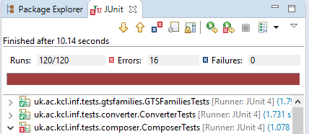


Test-driven development
Pick a user story
Write Test
Implement solution
Refactor
Pass Test
Notes:
The key idea is that rather than jumping right in and implementing a solution for a user story, we <ANIMATE> start by writing a test.
This may seem counter-intuitive: how can a test run through if there isn’t even an implementation yet? And, indeed, the test will, initially, fail.
However, we have now achieved two things:
We have written an example of how we expect our new code to be used – typically easier done than writing the implementation, this provides documentation, but also is an important first step in the process of designing a solution.
We have evidence that our test will indeed capture whether our solution works: at the very least, we know it will not pass if there is no solution.
So, in this sense, a broken test at the start of TDD is a good thing.
Once we have a test, we start building an implementation. Here, we build the simplest implementation that <ANIMATE> makes the test pass.
This may not yet be the perfect solution, it’s probably a bit too specific and its implementation will likely not be particularly clean. But, at least we know that we can build a solution and we have an example in front of us that we can improve.
As a first step of improving our implementation, we <ANIMATE> refactor it. Note that our test helps us here, too, as it gives us an indication when we’re starting to change behaviours rather than refactoring the implementation.
To ensure we have a complete implementation of the user story, we then <ANIMATE> write more tests and go around the loop again until we have enough tests to satisfy ourselves that we have correctly implemented the user story. For every test we add, we expect to see it fail – adding a test that goes through right away doesn’t help us move the implementation forward.

Slide 14
Test-driven development
Writing tests before code clarifies requirements to be implemented
Tests are programs rather than data
Can be executed automatically
Test includes a check that it has executed correctly
Usually relies on a testing framework such as Junit.
All tests previous and new are run automatically when new functionality is added
Checks new functionality has not introduced errors
Notes:
Benefits of TDD include that writing tests can help clarify requirements by giving examples of typical usage scenarios and that they give us an executable rendering of the requirements, enabling automated checking.
We have already spoken about the benefits of an automated test suite last week.

Slide 15
Problems with test-driven development
Test quality:
Programmers prefer programming to testing
May take shortcuts when writing tests
For example, incomplete tests not checking for all possible exceptions
Some tests can be very difficult to write incrementally
For example, in complex user interfaces writing unit tests for ‘display logic’ and workflow between screens
Difficulty judging completeness of a set of tests without a full specification
You may have a lot of system tests, but do they provide complete coverage
Software quality:
“Testability” may become more important than usability and robust software architecture
Notes:
But of course there are potential drawbacks, too, with TDD:
<ANIMATE> TDD doesn’t necessarily lead to a high-quality test suite. Programmers prefer programming to testing, so may take shortcuts when writing tests and “give up early” when going round the loop. Generally, nobody likes to break their own code, right? TDD helps with the latter problem a little, as a broken test is actually a useful and positive thing in TDD, but it’s still not perfect. More importantly, it can be difficult to write tests incrementally for some functionalities, making it difficult to make incremental progress in a TDD manner. Finally, when TDD replaces a full system specification, how do we know we have a complete set of tests?
<ANIMATE> TDD may create strange incentives for software quality. In particular, testability may become more important than usability and robust software architecture. Often, refactorings that lead to better testability also lead to a more robust software architecture, but that’s not always the case.

Slide 16
Influential XP practices
XP focus is mainly technical
Not easy to integrate with organizational management practices
Consequently, only some of the practices are being used, but the surrounding method has been refined
Practices that survive:
Minimum viable product and incremental releases
User stories for specification
Refactoring
Test-driven development
Pair programming
Notes:
Let us finally look at pair programming.

Slide 17
Pair programming
Programmers sit together at the same computer to develop software
Pairs created dynamically
All team members work with each other at some point
Enables knowledge sharing and learning
Reduces the overall risks to a project when team members leave
“Bus” or “truck” factor increases [1]
Creates common ownership
Not necessarily inefficient
Some evidence suggests a pair working together is more efficient than 2 programmers working separately
Serves as an informal review process
See [2] for an interesting analysis
[1] Avelino, Guilherme; Passos, Leonardo; Hora, Andre; Valente, Marco Tulio: A novel approach for estimating Truck Factors. IEEE 24th Int’l Conference on Program Comprehension (ICPC 2016)
[2] Alistair Cockburn and Laurie Williams. The costs and benefits of pair programming. Extreme programming examined, pp 223–248, 2001.
Notes:
Pair programming means that two people work together to write one piece of code / implement one user story.
Ideally, pairs are created dynamically and different team members collaborate at different times.
This allows knowledge to spread through the team over time and reduces the risks associated to team members leaving.
It effectively increases the “bus factor” of the project, that is the number of people that could be “run over by a bus” before the project becomes unsustainable. Projects where key functionality is understood only by one team member have a really bad bus factor of 1. Teams where every member can, in principle, contribute to all features, have the best possible bus factor. In practice, most teams are somewhere in between.
Interestingly, pair programming isn’t necessarily inefficient. There is evidence to suggest that a pair of programmers can be more efficient than a single programmer working alone, especially when considering the cost of code review, and can produce better-quality code. This is presumably because pair programming creates an informal, continuous review process.

Slide 18
Styles of pair programming
Pair programming is practised in different ways in the industry
Driver and Co-Pilot
This is the original proposal for pair programming
Programmers are meant to take on two distinct roles:
Driver has the keyboard and is writing code
Co-Pilot watches and comments, suggesting improvements and refactorings
Regular switching of roles ~every 10 mins
Frequent switching
This is probably the more frequently occurring practice
No clear roles, but frequent switching of keyboard control, possibly mid-statement
Sometimes even with two keyboards and mice (that’s for the pro-pair programmer, though)
Single programming
Individual programmers rather than pairs
Sometimes accompanied by “we should be doing more pair programming”
Notes:
There are different styles of pair programming.
The originally proposed variant differentiates a “driver” and a “co-pilot”. The driver has the keyboard and is writing code with the co-pilot watching and commenting, suggesting improvements and refactorings as they go. Every 10 minutes or so, the two developers switch roles.
In practice, <ANIMATE> roles are much less clear and switching is much more ad hoc, possibly mid-statement. The proper “pro” variant of this is where both developers have their own mouse and keyboard and just share one computer.
<ANIMATE>
The final, and sadly most frequent form or pair programming is “single programming”. This is often accompanied by statements of “we should be doing more pair programming”.
----
This ends our discussion of extreme programming and its contributions to agile. As we have already mentioned, XP has provided many techniques, but isn’t particularly strong on process. On KEATS, you will find the next video, which introduces you to Kanban – a first step towards an agile process and management.
<CTRL-SHIFT-END>

